Slide 1
accordion
Taught by Yossef Ayman Zedan

Slide 2
Overview
When thinking about the accordion, we need to think about what to toggle and how to target a content to appear when we click on the accordion header
First, we usually use buttons to add the accordion header.
Secondly, we use data-bs-toggle="collapse” to toggle the collapse.
Third, data-bs-target="#” to target the content we want to appear/hide when accordion header is clicked on. Hash is used because we usd id=“” for the div parent element of the content.

Slide 3
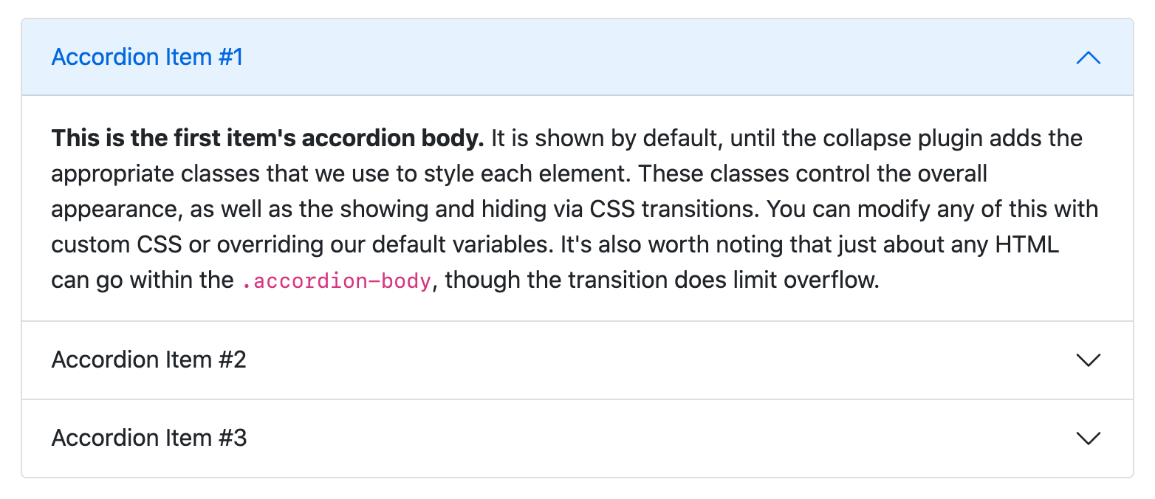
What do we toggle in accordion?

Slide 4
What do we toggle in accordion?
If we take a look at the image in the previous slide, we can find that the first accordion item has blue background color for the header and the content is not collapsed.
If we check its HTML code, we can find:
<button class="accordion-button" type="button" data-bs-toggle="collapse" data-bs-target="#panelsStayOpen-collapseOne”>Accordion Item #1 </button>
If we want to make it as the second and the last one, we will add class ”. collapsed” beside to the accordion-button to be: class="accordion-button collapsed”.

Slide 5
What do we toggle in accordion?
If we want to make it as the second and the last one, we will add class ”. collapsed” beside to the accordion-button to be: class="accordion-button collapsed”.
The text is not yet collapsed. To do that we can simply delete the class “show” which is not there for the rest of items at: <div id="collapseOne" class="accordion-collapse collapse show" data-bs-parent="#accordionExample"> <div class="accordion-body">Accordion content. </div> </div> </div>

Slide 6
Conclusion
We can conclude that when we click on the accordion button, we toggle the class “collapsed” for the button and ”show” for the content
We add data-bs-parent to make it under the control of the id of the accordion, so when we click on an another item, the previous item will be auto collapsed

Slide 7
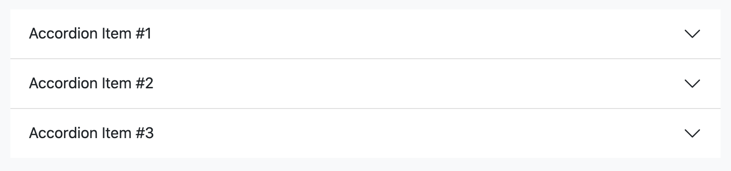
Flush
Add .accordion-flush to remove the default background-color, some borders, and some rounded corners to render accordions edge-to-edge with their parent container.
<div class="accordion accordion-flush">
</div>

Slide 8
Always open
If we want to make it always open, we can simply delete the data-bs-parent from the accordion-collapse class

